Slide 1
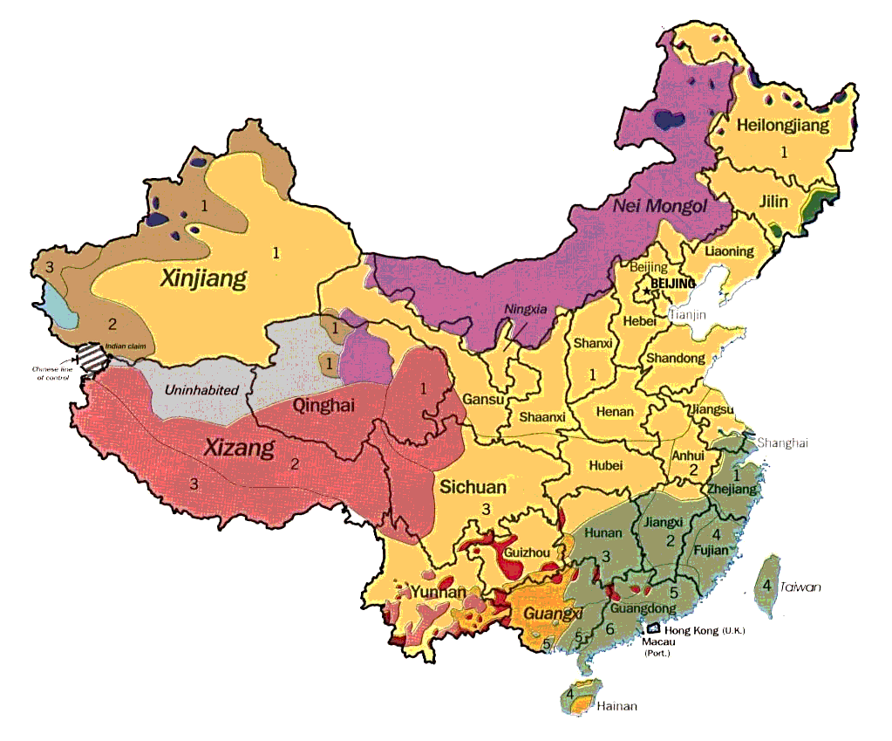
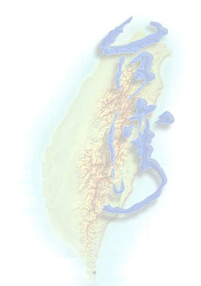
Mandarin Dictation System
國語聽寫系統
Speech lab., Institute of Comm., NTU
Philips Research East Asia, Taipei
王瑞璋 D87942013
18 July 2001

Slide 2
Presentation Overview
Introduction to the dictation system
  Problem description
  System components
  System architecture
Further discussion
  Phonetic Model - basic sounds
  Tone
  Language Model - word combination
  Results & Summary
Ref:
  Rabinar & Juang, “Fundamentals of Speech Recognition”, Prentice Hall.
  Frank Seide, Nick Wang. Phonetic modeling in the Philips Chinese continuous-speech recognition system. In Proc. ISCSLP’98, Singapore.
  Frank Seide, .., Nick Wang. SAMPA-C - A phonetic representation of Chinese for speech recognition. In Proc. COCOSDA’99, Taipei.

Slide 3
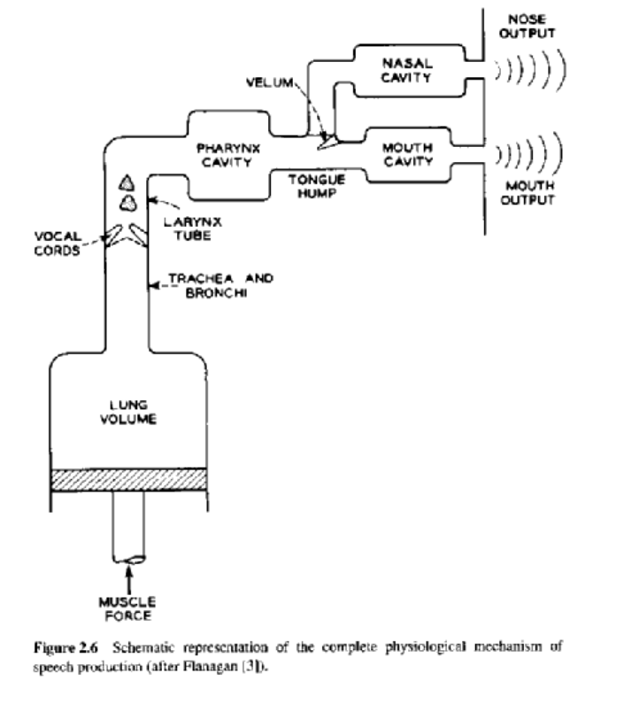
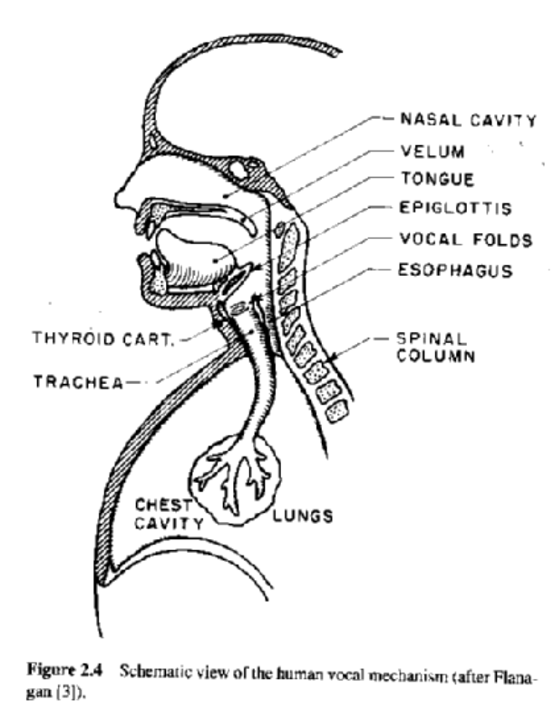
Problem Description
How sound is produced ?
Ref: Rabinar & Juang “Fundamentals of Speech Recognition”, Prentice Hall Inc.

Slide 4
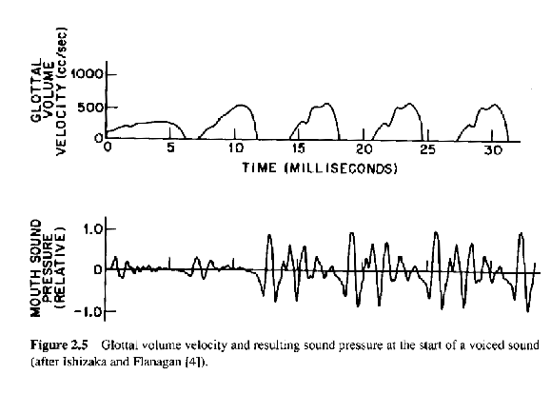
Problem Description
How sound is produced ?
Question: where is the fundamental frequency (f₀) ?
Ref: Rabinar & Juang “Fundamentals of Speech Recognition”, Prentice Hall Inc.

Slide 5
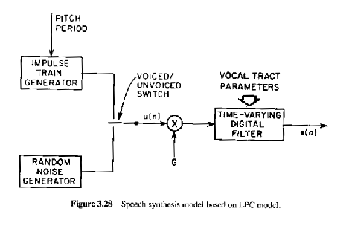
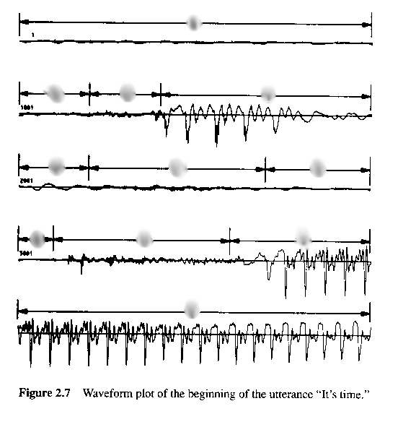
Problem Description
How sound is produced ?
Question: where is the voiced/unvoiced speech signal ?
Ref: Rabinar & Juang “Fundamentals of Speech Recognition”, Prentice Hall Inc.

Slide 6
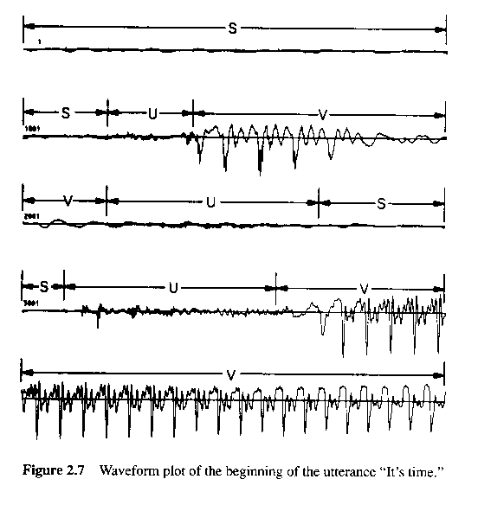
Problem Description
How sound is produced ?
S: Silence
V: Voiced
U: Unvoiced
Ref: Rabinar & Juang “Fundamentals of Speech Recognition”, Prentice Hall Inc.

Slide 7
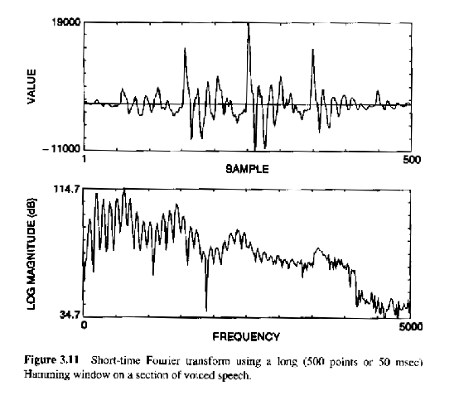
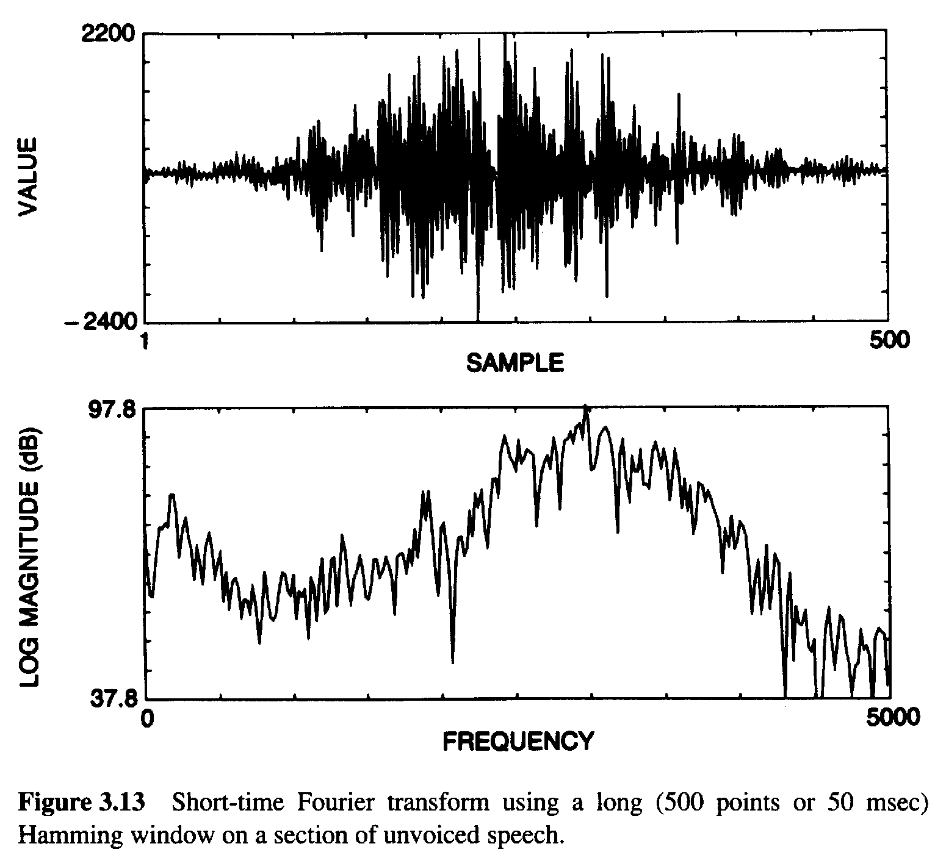
Problem Description
How sound is produced ?
Question: 1. where is the fundamental frequency (f₀) ?
2. where are the formants (major resonance frequencies) ?
Voiced
Unvoiced
Fig 3.14
(page 83)
Ref: Rabinar & Juang “Fundamentals of Speech Recognition”, Prentice Hall Inc.

Slide 8
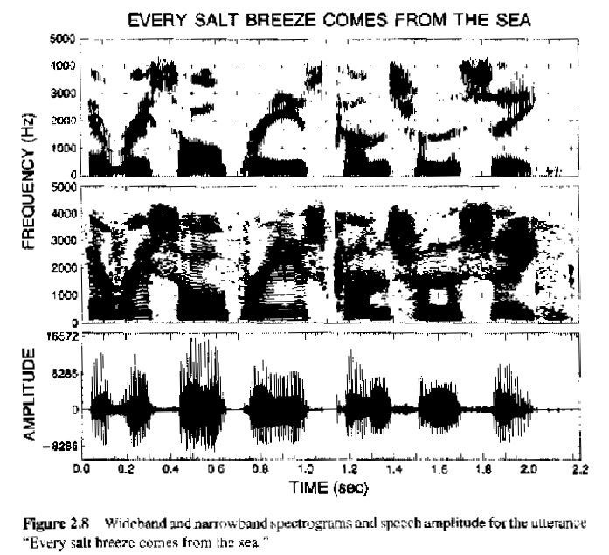
Problem Description
How sound is produced ?
1. How to recognize
a sentence ?
2. Can you tell
the formants and f₀ ?
Ref: Rabinar & Juang “Fundamentals of Speech Recognition”, Prentice Hall Inc.

Slide 9
Problem Description
Questions ?

Slide 10
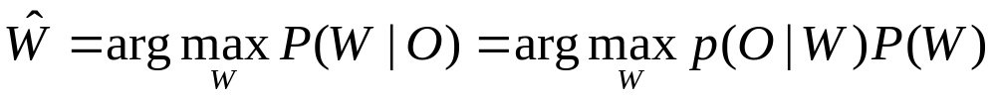
Components of a
Speech Recognition System
What do we need to recognize a sentence ?
Example: “水餃一碗,多少錢?”
1. How the recognizer work - based on MAP decision criterion
2. Acoustic/Phonetic Model
3. Pronunciation Lexicon
4. Tone Model
5. Language Model
acoustic model
language model
O: observation vectors, W: potential word sequence

Slide 11
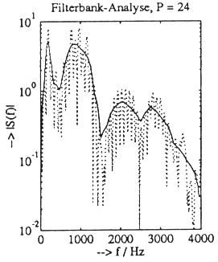
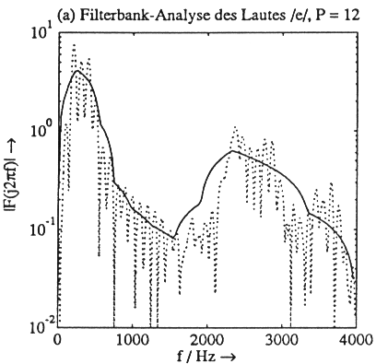
Components of a
Speech Recognition System
What do we need to recognize a sentence ?
Example: “水餃一碗,多少錢?”
1. Recognizer: MAP decision criterion
2. We need to know what basic syllables sound like.
  => Acoustic / phonetic model.
  Phone table:
  Defines the basic sounds of the language.
  400 syllables are formed from these sounds.
  Acoustic model:
  What does each sound of the language sound like
  (Idea: store template “features” like
  averaged power spectra).
  Acoustic model learned (“trained”) automatically
  from large corpora.
Phoneme Map
...
shui ㄕㄨㄟ
jiao ㄐㄧㄠ
yi 一
wan ㄨㄢ
xie ㄒ一ㄝ
ba ㄅㄚ
...
μ _{ㄚ}
μ _{ㄝ}

Slide 12
Components of a
Speech Recognition System
What do we need to recognize a sentence ?
Example: “水餃一碗,多少錢?”
1. Recognizer: MAP decision criterion
2. Acoustic/phonetic model.
3. We need to know how words are pronounced.
  => Pronunciation lexicon.
  40~64K words
  word = syllable sequence
Lexicon
...
水餃 shui jiao
一 yi
碗 wan
多少 duo shao
錢 qian
...

Slide 13
Components of a
Speech Recognition System
What do we need to recognize a sentence ?
Example: “水餃一碗,多少錢?”
1. Recognizer: MAP decision criterion
2. Acoustic/Phonetic model.
3. Pronunciation lexicon.
4/5. How do we know it’s not “睡覺一晚,多少錢” ?
  tone model language model
  A tone model to distinguish the 5 lexical tones.
  (In total, Mandarin has 1350 tonal syllables.)
  The language model “knows” which words are likely
  to go together by looking at the linguistic context.
Lexicon
(with tones)
...
水餃 shui3(2) jiao3
睡覺 shui4 jiao4
一 yi1
碗 wan3
晚 wan3
多少 duo1 shao3
錢 qian2
...

Slide 14
Speech Recognizer Architecture
Preprocessing
(front end)
Decoder
Postprocessing
(back end)
Viterbi search (integrated or multi-stage)
(structural/lexical constraints, pruning threshold)
spectral
analysis
spectral
features
phonetic
match
word
match
best
path
word sequence
22
A/D
word
lattice
alternative
best path
tonal *
match
pitch *
analysis
pitch
features
4
* tonal languages
only
signal
analysis
parameters
acoustic/
phonetic
model
(HMMs)
tone *
model
(HMMs)
pronunc.
lexicon
(dictionary)
bi- or trigram
language
model
higher-order
N-gram,
understanding
grammar, etc.
Models (factory-trained, user-adapted)

Slide 15
Introduction to the Dictation System
What do we need to recognize a sentence ?
Example: “水餃一碗,多少錢?”
Questions:
1. Recognizer: what is detection criterion ?
2. What is the basic pronunciation component ?
3. Which components decide the vocabulary size of a dictation system ?
4. How does the system decide it is the above sentence or the next one
“睡覺一晚,多少錢” ?

Slide 16
Introduction to the Dictation System
What do we need to recognize a sentence ?
Example: “水餃一碗,多少錢?”
Questions:
1. Recognizer: what is detection criterion ?
MAP detection: max Prob(W|O) = max Prob(O|W) Prob(W)
2. What is the basic pronunciation component ?
phone table and the corresponding cepstral/spectral distributions
3. Which components decide the vocabulary size of a dictation system ?
lexicon and language model
4. How does the system decide it is the above sentence or the next one
“睡覺一晚,多少錢” ?
by the tone model and the language model

Slide 17
Components of a
Speech Recognition System
Questions ?

Slide 18
Speech Recognizer Architecture
Preprocessing
(front end)
Decoder
Postprocessing
(back end)
Viterbi search (integrated or multi-stage)
(structural/lexical constraints, pruning threshold)
spectral
analysis
spectral
features
phonetic
match
word
match
best
path
word sequence
22
A/D
word
lattice
alternative
best path
tonal *
match
pitch *
analysis
pitch
features
4
* tonal languages
only
signal
analysis
parameters
acoustic/
phonetic
model
(HMMs)
tone *
model
(HMMs)
pronunc.
lexicon
(dictionary)
bi- or trigram
language
model
higher-order
N-gram,
understanding
grammar, etc.
Models (factory-trained, user-adapted)

Slide 19
Phonetic Model:
What syllables are made of.
Central questions:
  What are the basic sounds of Chinese ?
    Example: Bo-Po-Mo-Fo
    Western style phone-like units
    水 shu(e)i = sh + u + ei
    Half-syllabic units
    水 shu(e)i = sh + uei
    shu(e)i = shu + ei
  What happens to them when you speak
  them together ?
  => Modeling of coarticulation.
    小 xiao = sh + iao
    學 xue = sh + ue
  Model-parameter sharing.
Phoneme Map
...
li ㄌ一
xie ㄒ一ㄝ
ba ㄅㄚ
...
μ _{ㄚ}
μ _{ㄝ}

Slide 20
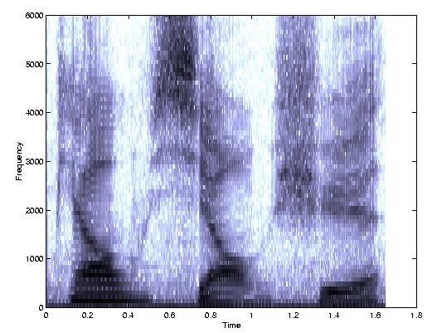
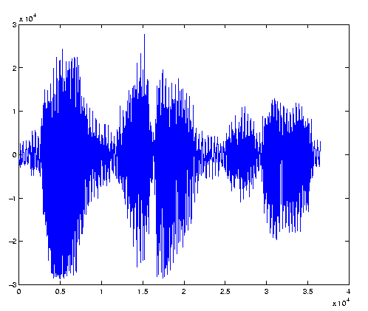
Phonetic Model:
What syllables are made of.
Coarticulation:
  Realization of a sound
  is influenced by the
  neighbor sounds.
ㄆ一 ㄠ ㄒ 一 ㄠ ㄒ ㄩ ㄝ
(piao1) (xiao3) (xue2)

Slide 21
Phonetic Model:
What syllables are made of.
Coarticulation:
  Realization of a sound
  is influenced by the
  neighbor sounds.
  Examples:
    1. Initial ㄒ very different
    (mouth shape).
    2. 一 influence from initial.
    3. ㄠ quite stable.
ㄆ一 ㄠ ㄒ 一 ㄠ ㄒ ㄩ ㄝ
(piao) (xiao) (xue)

Slide 22
Phonetic Model:
What syllables are made of.
Coarticulation:
  Realization of a sound
  is influenced by the
  neighbor sounds.
  Examples:
    1. Initial ㄒ very different
    (mouth shape).
    2. 一 influence from initial.
    3. ㄠ quite stable.
ㄆ一 ㄠ ㄒ 一 ㄠ ㄒ ㄩ ㄝ
(piao) (xiao) (xue)

Slide 23
Phonetic Model:
What syllables are made of.
Coarticulation:
  Realization of a sound
  is influenced by the
  neighbor sounds.
  Examples:
    1. Initial ㄒ very different
    (mouth shape).
    2. 一 influence from initial.
    3. ㄠ quite stable.
ㄆ一 ㄠ ㄒ 一 ㄠ ㄒ ㄩ ㄝ
(piao) (xiao) (xue)

Slide 24
Phonetic Model:
What syllables are made of.
Coarticulation:
  Realization of a sound
  is influenced by the
  neighbor sounds.
  Examples:
    1. Initial ㄒ very different
    (mouth shape).
    2. 一 influence from initial.
    3. ㄠ quite stable.
  Solution:
  Context-dependent
  versions of the phone models.
ㄆ一 ㄠ ㄒ 一 ㄠ ㄒ ㄩ ㄝ
(piao) (xiao) (xue)

Slide 25
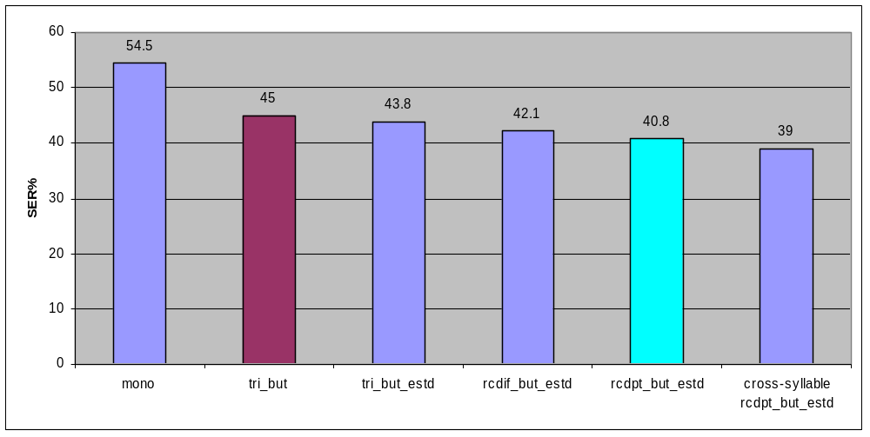
Phonetic Model:
What syllables are made of.
Study of groupings, context dependency, and sharing:
Results: Western style phone-like units half-syllabic units
  Coarticulation is important!! (mono=>tri_but: 17% relative gain)
  Further optimization yields reduction from 45% to 39% (13% rel.).
  (phone-like units => half-syll. => sharing)

Slide 26
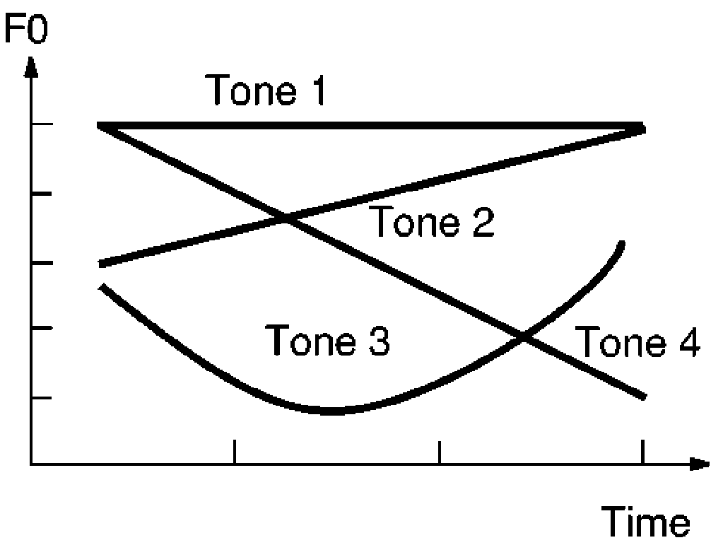
How about tones ?
Central questions:
  1. How to measure the pitch contour reliably ?
  2. How to combine the two models (tone, spectral) ?
  Something like p(O|w) = p(O_{spectral}|w) ·p(O_{pitch}|w) … ?
Tone patterns:

Slide 27
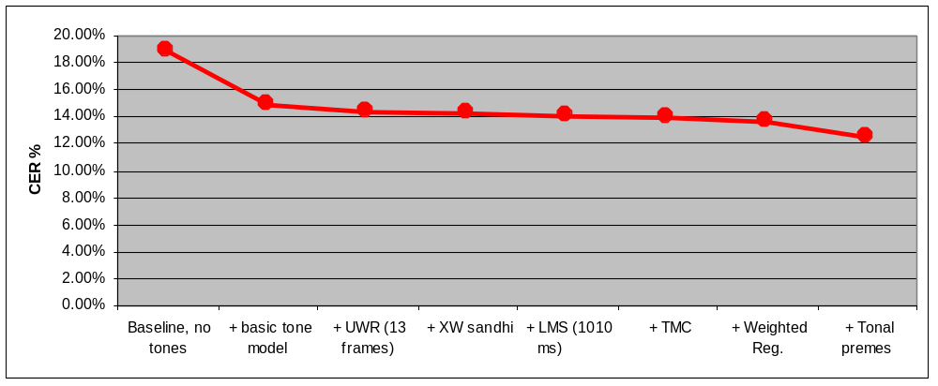
How about tones ?
Central questions:
  1. How to measure the pitch contour reliably ?
  2. How to combine the two models (tone, spectral) ?
  Something like p(O|w) = p(O_{spectral}|w) ·p(O_{pitch}|w) … ?
Results for
microphone
dictation:
  => Character Error Rate reduction compared to toneless: generally ~20-30% rel.!
no tone
model
1st tone
model
current

Slide 28
Speech Recognizer Architecture
Preprocessing
(front end)
Decoder
Postprocessing
(back end)
Viterbi search (integrated or multi-stage)
(structural/lexical constraints, pruning threshold)
spectral
analysis
spectral
features
phonetic
match
word
match
best
path
word sequence
22
A/D
word
lattice
alternative
best path
tonal *
match
pitch *
analysis
pitch
features
4
* tonal languages
only
signal
analysis
parameters
acoustic/
phonetic
model
(HMMs)
tone *
model
(HMMs)
pronunc.
lexicon
(dictionary)
bi- or trigram
language
model
higher-order
N-gram,
understanding
grammar, etc.
Models (factory-trained, user-adapted)

Slide 29
Language Model:
Getting the words right.
Purpose: provide prior probability P(W) of a word sequence W
=> statistics which word goes well with another.
  Necessary for converting from (tonal) syllable to character to resolve ambiguity: 水餃一碗多少錢 / 睡覺一晚多少錢
  But most important ambiguity is in our acoustic models!!
Approach:
  P(W) = P(W_{N}|W_{N-1}, W_{N-2}, ...) ·P(W_{N-1}|W_{N-2}, W_{N-3}, ...) ·… · P(W₁)
  = P(W_{N}|W_{N-1}) ·P(W_{N-1}|W_{N-2}) ·… · P(W₁)
  So-called “bigram” approach (bi-gram = ancient Greek: pair of words)
  State-of-the-art: “trigrams” (word triples) or M-grams
Central questions:
  Sparseness of data: Seeing all possible pairs/triples/… is not feasible.
  What are the “words” in Chinese ?
  How to segment a string of characters into words ?
  (“Small” item: Text cleaning and normalization)

Slide 30
Language Model:
Getting the words right.
Word definition for Chinese:
  Manually create a word list
  Automatically based on statistical methods
    Initialize: “single character words”
    Group a sequence of words into one longer new word if the LM improves.
    Iterate until no/little improvement.
Word segmentation
  Approach: “longest match”.
  Algorithm:
    Identify all possible segmentations and choose the one with least words.
    In case of multiple solutions, decide by unigram counts.

Slide 31
Language Model:
Getting the words right.
Word definition for Chinese:
  Manually create a word list
  Automatically based on statistical methods
    Initialize: “single character words”
    Group a sequence of words into one longer new word if the LM improves.
    Iterate until no/little improvement.
Word segmentation
  Approach: “longest match”.
  Algorithm:
    Identify all possible segmentations and choose the one with least words.
    In case of multiple solutions, decide by unigram counts.

Slide 32
Results & Summary
45.0%
Western phone-like model
optimize phonetic models
to Chinese: -9.3%
Observations:
  Many small improvements
  … that sum up!
  Language model important
  Tone model important
  More data => better performance
  Principally, speech recognition is easy
  … you just have to do everything right!”
  - Prof. Hermann Ney
  We probably still do most of the things wrong.
  To identify these & improve upon is our daily
  work as researchers. Let’s make things better!
40.8%
Half-syllabic model
cross-syllable
models: -4.4%
(new test set)
(36.4%)
39.0%
(new train
set)
bigram LM (new)
(-40.7%)
(35.6%)
21.6%
GD models:
-4.8%
trigram:
-10.2%
33.9%
VTLN/MLLR:
-1.8%
19.4%
33.3%
tones:
-35%
bigram LM (-28.2%)
12.6%
23.9%

Slide 33
Mandarin Dictation System
Questions ?

Slide 34
Moving from Desktop PC to Mobile device
Speech recognition everywhere
Market trend
  SmartPhone (mobile phone & PDA) will appear in the near future.
  Speech interface becomes very important in small devices.
  Personal devices provide higher privacy and security.
  Wireless provides a smart way to connect with other devices.
Application
  PDA functions
  Email or take notes
  Information access
  Home appliance user interface

Slide 35
Moving from Desktop PC to Mobile device
Speech recognition everywhere
Technology
  Compact and fast speech recognizer: search engine
  Natural-language voice control
  Robust speech recognition in different environments
    in the car
    on the move
    at home
    in the office
    whispering
  Distributed speech recognition
    Simple phone client + network computer server
  Multi-modal interaction
    speech + graphic interaction
  Personalization

